Slide 1
Data Structure and Algorithms
(CS212)
Instructor : Dr Syed Musharaf Ali

Slide 2
Asymptotic Analysis
Whenever we want to perform analysis of an algorithm, we need to calculate the complexity of that algorithm.
When we calculate complexity of an algorithm it does not provide exact amount of resource required.
So instead of taking exact amount of resource we represent that complexity in a general form (Notation) which produces the basic nature of that algorithm.
Asymptotic notation of an algorithm is a mathematical representation of its complexity
Notes:
The definition of asymptotic is a line that approaches a curve but never touches. A curve and a line that get closer but do not intersect are examples of a curve and a line that are asymptotic to each other.
Asymptote, a line always approaching some curve but never meeting it.

Slide 3
Asymptotic Analysis
Asymptotic analysis is input bound i.e., if there's no input to the algorithm, it is concluded to work in a constant time. Other than the "input" all other factors are considered constant.
We use only the most significant terms in the complexity of an algorithm and ignore least significant terms in the complexity of that algorithm e.g.
Algorihtm 1 : 5n² + 2n + 1
Algorihtm 2 : 10n² + 8n + 3
For larger value of n
Most significant terms are : 5n² and 10n²
Least significant terms are: (2n + 1) and (8n + 3)
The running time of function f(n) will increase linearly with the increase in n.
The running time of the function g(n²) will increase exponentially when n increases.
Similarly, the running time of both operations will be nearly the same if n is significantly small.
Notes:
The definition of asymptotic is a line that approaches a curve but never touches. A curve and a line that get closer but do not intersect are examples of a curve and a line that are asymptotic to each other.
Asymptote, a line always approaching some curve but never meeting it.

Slide 4
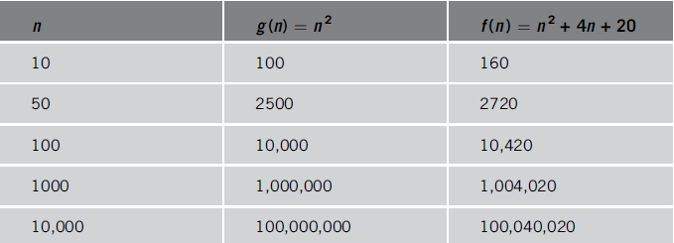
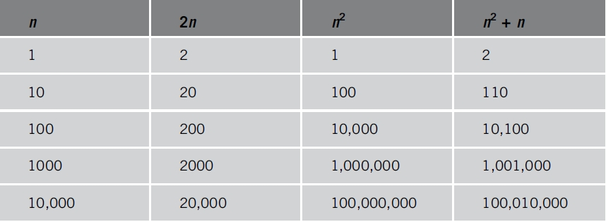
Asymptotic Analysis
LST and MST
Various values of n² and n² + 4n + 20n
Various values of n, 2n, n², and n² + n
Notes:
The definition of asymptotic is a line that approaches a curve but never touches. A curve and a line that get closer but do not intersect are examples of a curve and a line that are asymptotic to each other.
Asymptote, a line always approaching some curve but never meeting it.

Slide 5
Asymptotic Analysis
Usually, the time required by an algorithm falls under three types
Best Case − Minimum time required for program execution.
Average Case − Average time required for program execution.
Worst Case − Maximum time required for program execution.

Slide 6
Asymptotic Analysis
There are three types of Asymptotic Notations
Big - Oh (O) …………. (worst case)
Big - Omega (Ω)……. (Best case)
Big - Theta (Θ)……....(Average case)
Notes:
https://www.youtube.com/watch?v=aGjL7YXI31Q
http://btechsmartclass.com/DS/U1_T5.html

Slide 7
Asymptotic Analysis
Big - Oh Notation (O)
Big - Oh notation is used to define the upper bound of an algorithm in terms of Time Complexity.
Big - Oh notation always indicates the maximum time required by an algorithm for all input values.
That means Big - Oh notation describes the worst case of an algorithm time complexity.
Notes:
https://www.youtube.com/watch?v=aGjL7YXI31Q
http://btechsmartclass.com/DS/U1_T5.html

Slide 8
Asymptotic Analysis
Big - Oh Notation (O)
Definition:
If f(n) <= C g(n) , for all n >= n₀, C > 0 and n₀ >= 1.
Then we can represent f(n) as O(g(n)).
f(n) = O(g(n))
Notes:
https://www.youtube.com/watch?v=aGjL7YXI31Q
http://btechsmartclass.com/DS/U1_T5.html

Slide 9
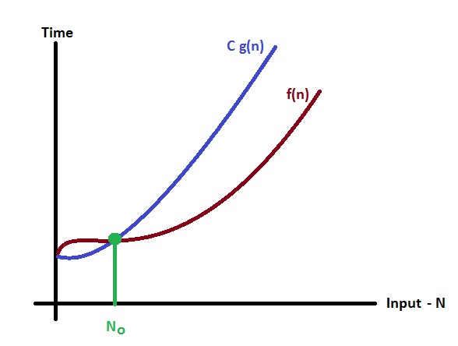
Asymptotic Analysis
Big - Oh Notation (O) – Example
Consider the following graph drawn for the values of f(n) and C g(n) for input (n) value on X-Axis and time required is on Y-Axis
In above graph after a particular input value n₀, C g(n) is always greater than f(n) which indicates the algorithm's upper bound.
Notes:
https://www.youtube.com/watch?v=aGjL7YXI31Q
http://btechsmartclass.com/DS/U1_T5.html

Slide 10
Asymptotic Analysis
Big - Oh Notation (O) – Example
Consider the following f(n) and g(n)...
f(n) = 3n + 2 g(n) = n
If we want to represent f(n) as O(g(n)) then it must satisfy f(n) <= C g(n) for all values of C > 0 and n₀>= 1
f(n) <= C g(n) 3n + 2 <= C n Above condition is always TRUE for all values of C = 4 and n >= 2. By using Big - Oh notation we can represent the time complexity as follows...
3n + 2 = O(n)
Notes:
https://www.youtube.com/watch?v=aGjL7YXI31Q
http://btechsmartclass.com/DS/U1_T5.html

Slide 11
Asymptotic Analysis
Big - Omega Notation (Ω)
Big - Omega notation is used to define the lower bound of an algorithm in terms of Time Complexity.
Omega notation always indicates the minimum time required by an algorithm for all input values.
That means Big - Omega notation describes the best case of an algorithm time complexity.
Notes:
https://www.youtube.com/watch?v=aGjL7YXI31Q
http://btechsmartclass.com/DS/U1_T5.html

Slide 12
Asymptotic Analysis
Big - Omega Notation (Ω)
Definition:
If f(n) => C g(n) for all n >= n₀, C > 0 and n₀ >= 1.
Then we can represent f(n) as Ω(g(n)). f(n) = Ω(g(n))
Notes:
https://www.youtube.com/watch?v=aGjL7YXI31Q
http://btechsmartclass.com/DS/U1_T5.html

Slide 13
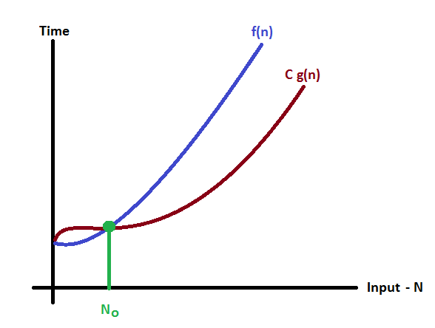
Asymptotic Analysis
Big - Omega Notation (Ω) – Example
Consider the following graph drawn for the values of f(n) and C g(n) for input (n) value on X-Axis and time required is on Y-Axis
In above graph after a particular input value n₀, always C g(n) is less than f(n) which indicates the algorithm's lower bound.
Notes:
https://www.youtube.com/watch?v=aGjL7YXI31Q
http://btechsmartclass.com/DS/U1_T5.html

Slide 14
Asymptotic Analysis
Big - Omega Notation (Ω) – Example
Consider the following f(n) and g(n)...
f(n) = 3n + 2 g(n) = n
If we want to represent f(n) as Ω(g(n)) then it must satisfy f(n) => C g(n) for all values of C > 0 and n₀>= 1
f(n) => C g(n) 3n + 2 => C n Above condition is always TRUE for all values of C = 1 and n >= 1. By using Big - Omega notation we can represent the time complexity as follows...
3n + 2 = Ω(n)
Notes:
https://www.youtube.com/watch?v=aGjL7YXI31Q
http://btechsmartclass.com/DS/U1_T5.html

Slide 15
Asymptotic Analysis
Big - Theta Notation (Θ)
Big - Theta notation is used to define the average bound of an algorithm in terms of Time Complexity.
Theta notation always indicates the average time required by an algorithm for all input values.
That means Big - Theta notation describes the average case of an algorithm time complexity.
Notes:
https://www.youtube.com/watch?v=aGjL7YXI31Q
http://btechsmartclass.com/DS/U1_T5.html

Slide 16
Asymptotic Analysis
Big - Theta Notation (Θ)
Definition:
If C₁ g(n) <= f(n) <= C₂ g(n) for all n >= n₀, C₁, C₂ > 0 and n₀ >= 1. Then we can represent f(n) as Θ(g(n)).
f(n) = Θ(g(n))

Slide 17
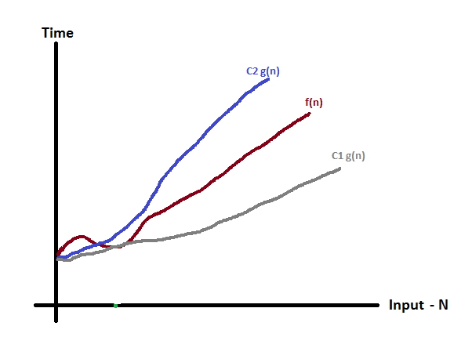
Asymptotic Analysis
Big - Theta Notation (Θ) – Example
Consider the following graph drawn for the values of f(n) and C g(n) for input (n) value on X-Axis and time required is on Y-Axis
In above graph after a particular input value n₀, always C₁ g(n) is less than f(n) and C₂ g(n) is greater than f(n) which indicates the algorithm's average bound.
Notes:
https://www.youtube.com/watch?v=aGjL7YXI31Q
http://btechsmartclass.com/DS/U1_T5.html

Slide 18
Asymptotic Analysis
Big - Theta Notation (Θ) – Example
Consider the following f(n) and g(n)...
f(n) = 3n + 2 g(n) = n
If we want to represent f(n) as Θ(g(n)) then it must satisfy C₁ g(n) <= f(n) <= C₂ g(n) for all values of C₁, C₂ > 0 and n₀>= 1
C₁ g(n) <= f(n) <= C₂ g(n) C₁ n <= 3n + 2 <= C₂ n Above condition is always TRUE for all values of C₁ = 1, C₂ = 4 and n >= 1. By using Big - Theta notation we can represent the time complexity as follows...
3n + 2 = Θ(n)
Notes:
https://www.youtube.com/watch?v=aGjL7YXI31Q
http://btechsmartclass.com/DS/U1_T5.html

Slide 19
Example
Asymptotic Analysis
for (j = 0; j < n; j++) {
statement1;
statement2;
statement3;
}
Upper bound = O(5n+1) = O(n)
Lower bound = Ω(6) = Ω(1)
Time Complexity = O(n)
Notes:
Algorithm Complexity - Loops with Break The case of a loop with a conditional breakout is shown in this slide. In the cases where the loop runs to normal termination, the run time of the loop is correctly modelled by the same function as for the simple loop above. But in other cases, the loop may terminate sooner. These cases are data dependent; that is, the runtime of the loop varies from an upper bound of 3n = O(n) to a lower bound of 3 = Ω(1), depending on the specific input to the loop. We cannot conclude that the algorithm has complexity Θ(n) because the lower bound condition >= Ω(n) does not hold. Therefore, the best we can conclude is that the loop has complexity <= O(n).

Slide 20
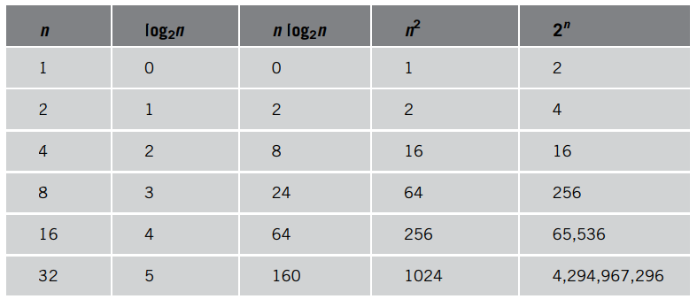
Asymptotic Analysis
Growth rate of various functions
Notes:
Algorithm Complexity - Loops with Break The case of a loop with a conditional breakout is shown in this slide. In the cases where the loop runs to normal termination, the run time of the loop is correctly modelled by the same function as for the simple loop above. But in other cases, the loop may terminate sooner. These cases are data dependent; that is, the runtime of the loop varies from an upper bound of 3n = O(n) to a lower bound of 3 = Ω(1), depending on the specific input to the loop. We cannot conclude that the algorithm has complexity Θ(n) because the lower bound condition >= Ω(n) does not hold. Therefore, the best we can conclude is that the loop has complexity <= O(n).

Slide 21
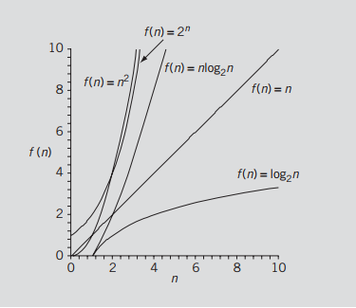

Asymptotic Analysis
Growth rate of functions
Notes:
Algorithm Complexity - Loops with Break The case of a loop with a conditional breakout is shown in this slide. In the cases where the loop runs to normal termination, the run time of the loop is correctly modelled by the same function as for the simple loop above. But in other cases, the loop may terminate sooner. These cases are data dependent; that is, the runtime of the loop varies from an upper bound of 3n = O(n) to a lower bound of 3 = Ω(1), depending on the specific input to the loop. We cannot conclude that the algorithm has complexity Θ(n) because the lower bound condition >= Ω(n) does not hold. Therefore, the best we can conclude is that the loop has complexity <= O(n).

Slide 22
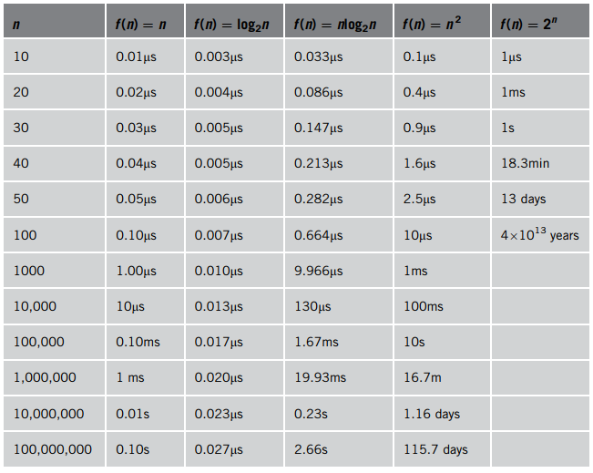
Asymptotic Analysis
Time for f(n) instructions on a computer that executes 1 billion instructions per second
Notes:
Algorithm Complexity - Loops with Break The case of a loop with a conditional breakout is shown in this slide. In the cases where the loop runs to normal termination, the run time of the loop is correctly modelled by the same function as for the simple loop above. But in other cases, the loop may terminate sooner. These cases are data dependent; that is, the runtime of the loop varies from an upper bound of 3n = O(n) to a lower bound of 3 = Ω(1), depending on the specific input to the loop. We cannot conclude that the algorithm has complexity Θ(n) because the lower bound condition >= Ω(n) does not hold. Therefore, the best we can conclude is that the loop has complexity <= O(n).

Slide 23
Asymptotic Analysis
Notes:
Algorithm Complexity - Loops with Break The case of a loop with a conditional breakout is shown in this slide. In the cases where the loop runs to normal termination, the run time of the loop is correctly modelled by the same function as for the simple loop above. But in other cases, the loop may terminate sooner. These cases are data dependent; that is, the runtime of the loop varies from an upper bound of 3n = O(n) to a lower bound of 3 = Ω(1), depending on the specific input to the loop. We cannot conclude that the algorithm has complexity Θ(n) because the lower bound condition >= Ω(n) does not hold. Therefore, the best we can conclude is that the loop has complexity <= O(n).

